Slide 1


Predicting and Preventing Theme Park Incidents
Miles A. Peña
April 2025
Notes:
Hi everyone, and thank you for being here. I'm Miles Alexander Peña. For this project, I utilized machine learning to analyze twenty years of data from Orlando’s major theme parks to enhance our understanding and prediction of guest safety incidents.

Slide 2
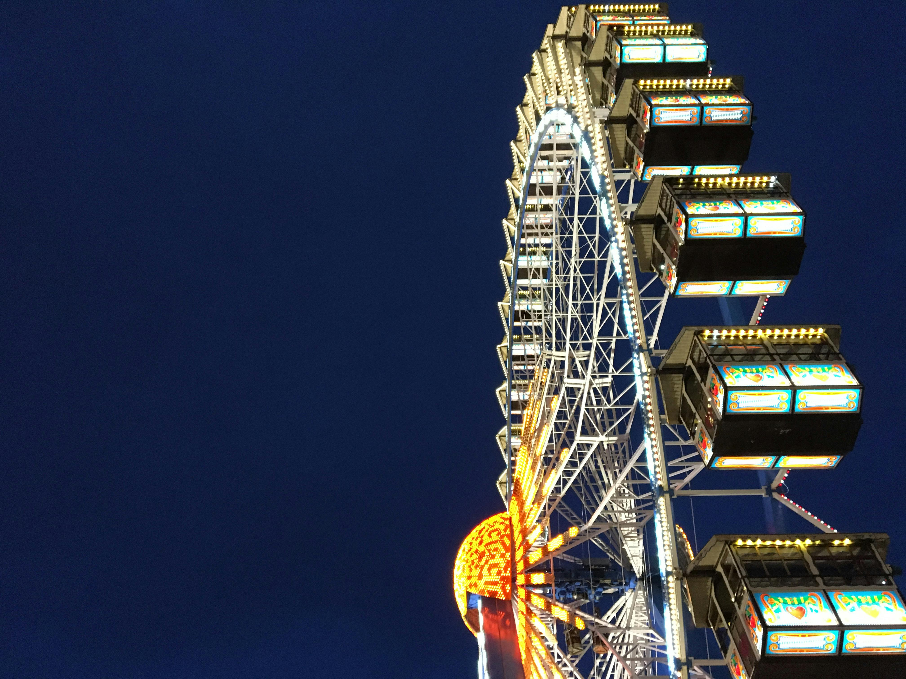
Project Overview
Analyzing 20 years of incident reports and weather data from Orlando theme parks to forecast risks and enhance guest safety.
Notes:
It combines over 680 incident reports with those 20 years of weather data to investigate when, where, and why safety issues occur at theme parks. The aim is to create predictive tools that enhance guest safety and inform operational planning.

Slide 3
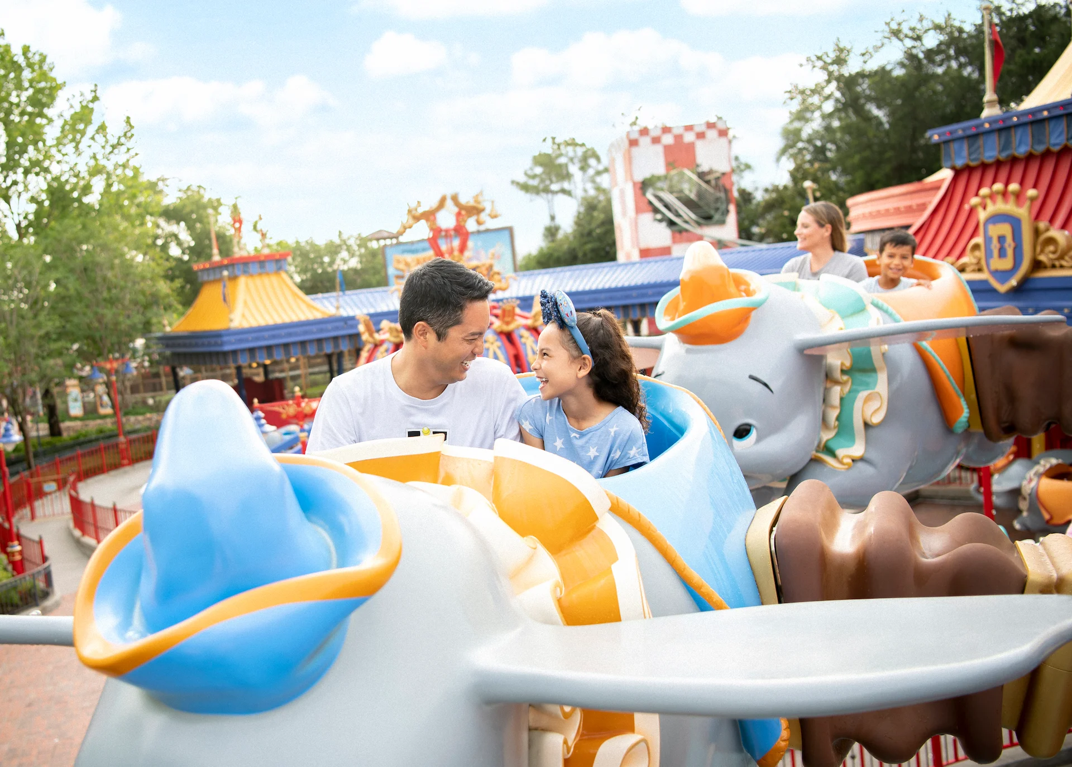
Business Problem
How can theme parks anticipate and prevent incidents before they happen?
Notes:
Guest safety is a primary concern for theme parks. Visitors come from around the world and rely on these theme parks and their operators to ensure their and their families' safety. Even a small number of incidents can undermine this trust and disrupt operations. The question we aim to address is: Can we identify patterns that lead to incidents and use that information to prevent future ones?

Slide 4
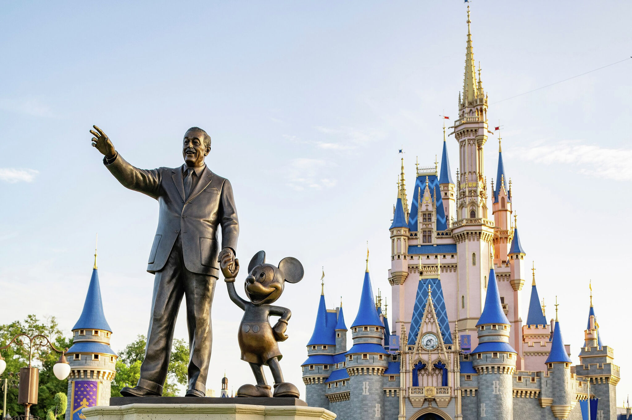
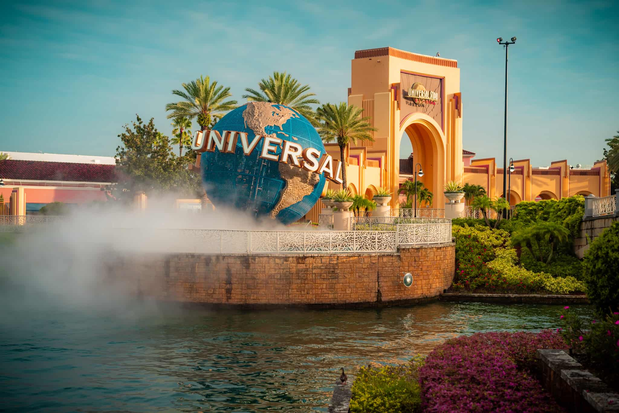
Data Sources & Preparation
FDACS incident reports for Walt Disney World Resort and Universal Studios Orlando (682 records)
Florida Climate Center weather data for the Orlando International Airport station (Jan 1, 2002 – Dec 31, 2022)
Cleaned, merged, and aligned on date
Notes:
Two datasets were utilized for this analysis. The first dataset is from the Florida Department of Agriculture and Consumer Services, which details incidents at Universal Studios Orlando and the Walt Disney World Resort. The second dataset comes from the Florida Climate Center and includes daily weather data for the Orlando International Airport station, covering the period from January 1, 2002, to December 31, 2022. The data was cleaned and merged by matching incident dates with weather conditions.

Slide 5

Methods
Exploratory Data Analysis (EDA) on incidents, ride types, and weather
Natural Language Processing (TF-IDF) on incident descriptions
Classification Modeling using Random Forest
Statistical Testing (t-test on weather conditions)
Considered Reinforcement Learning (not implemented)
Notes:
We utilized data analysis to examine trends in incidents, ride types, and weather. Next, we employed text analysis to identify common symptoms in the reports. Ultimately, we developed a model to predict whether an incident could be severe, based on ride and weather data. Although we considered utilizing reinforcement learning, it wasn’t created due to insufficient real-time data.

Slide 6
Key Findings
14.98% of all incidents happened on the hottest 10% of days
No spike during heavy rain
Common symptoms: dizziness, chest pain
Severity prediction reached ~80% accuracy
Notes:
We found that almost 15% of all reported incidents happened on the hottest 10% of days, which suggests that extreme heat is a real risk factor. On the other hand, rain didn’t seem to have much effect. Using text analysis, we saw that symptoms like dizziness, fainting, and chest pain appeared often. When we trained a model to predict how severe an incident might be, it reached about 80% accuracy using ride and weather data. Let’s take a look at some graphs that depict what we found.

Slide 7
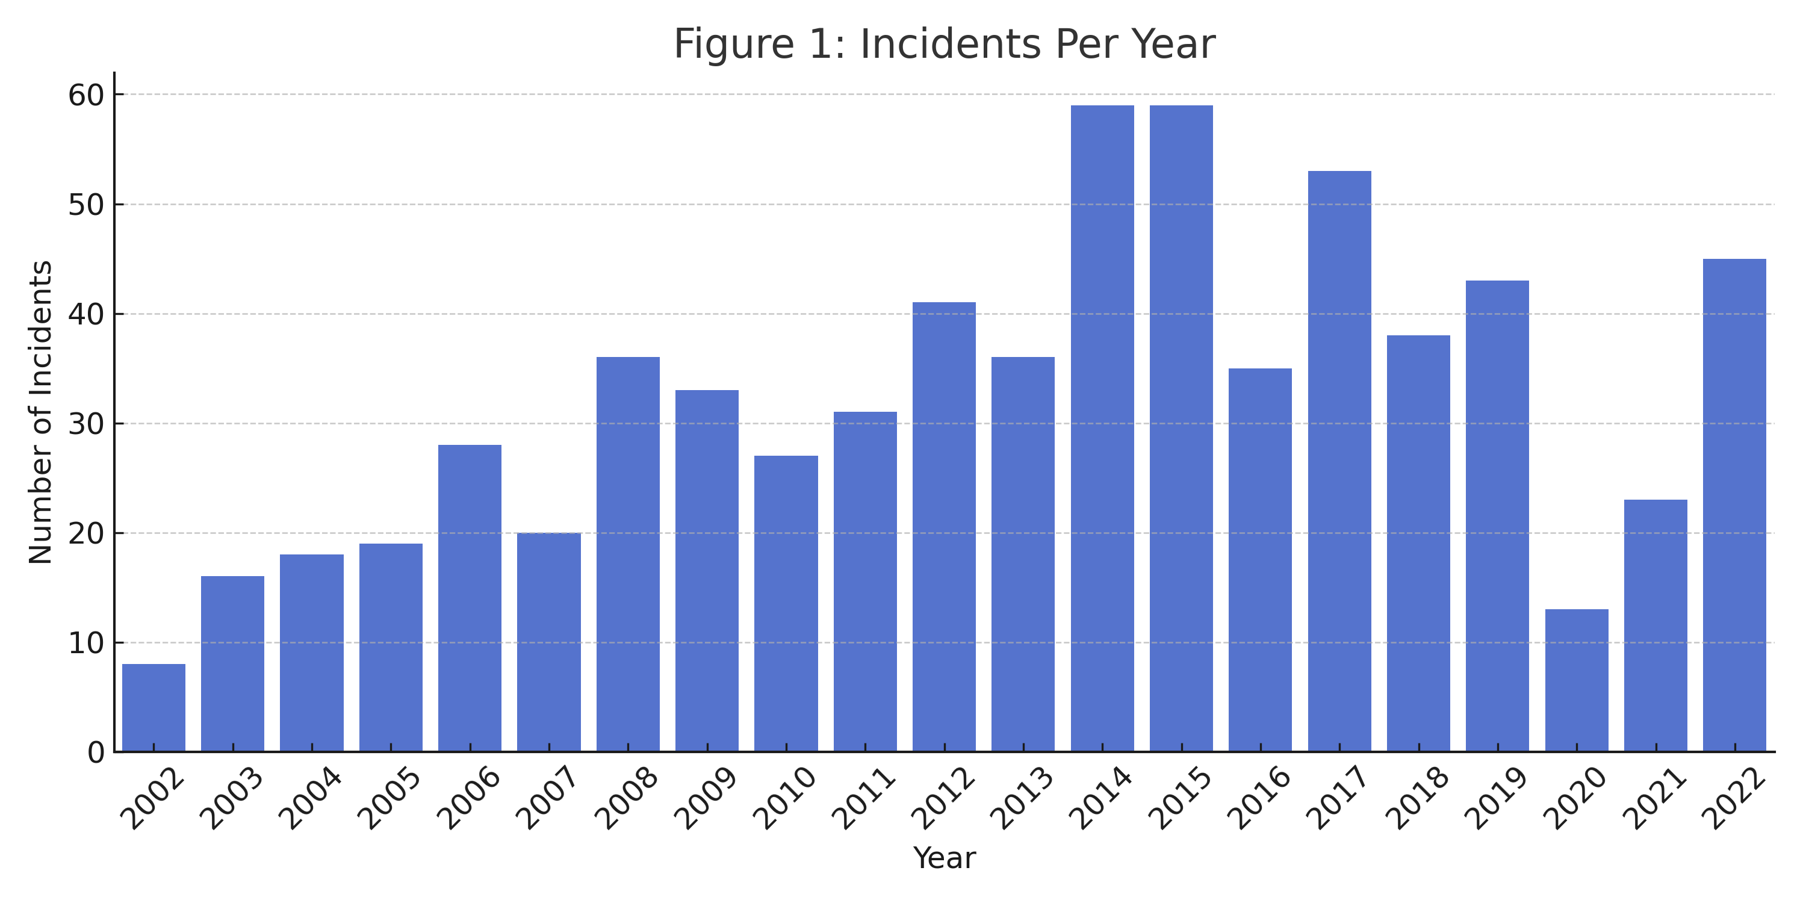
Notes:
This chart shows reported incidents each year between 2002 and 2022. The numbers stay fairly consistent, with a dip in 2020 due to the pandemic. What this tells us is that while incidents aren’t drastically increasing, they remain a regular part of park operations — making prediction and prevention valuable.

Slide 8
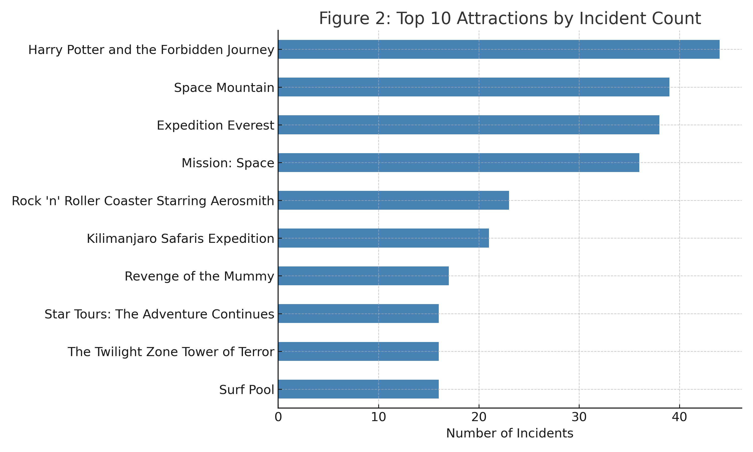
Notes:
Next, we looked at which rides had the most reported incidents. These are mostly high-intensity or high-traffic attractions. It’s important to note this doesn’t mean the rides are unsafe — it’s more about where incidents are likely to be reported, especially with guests who have pre-existing conditions.

Slide 9
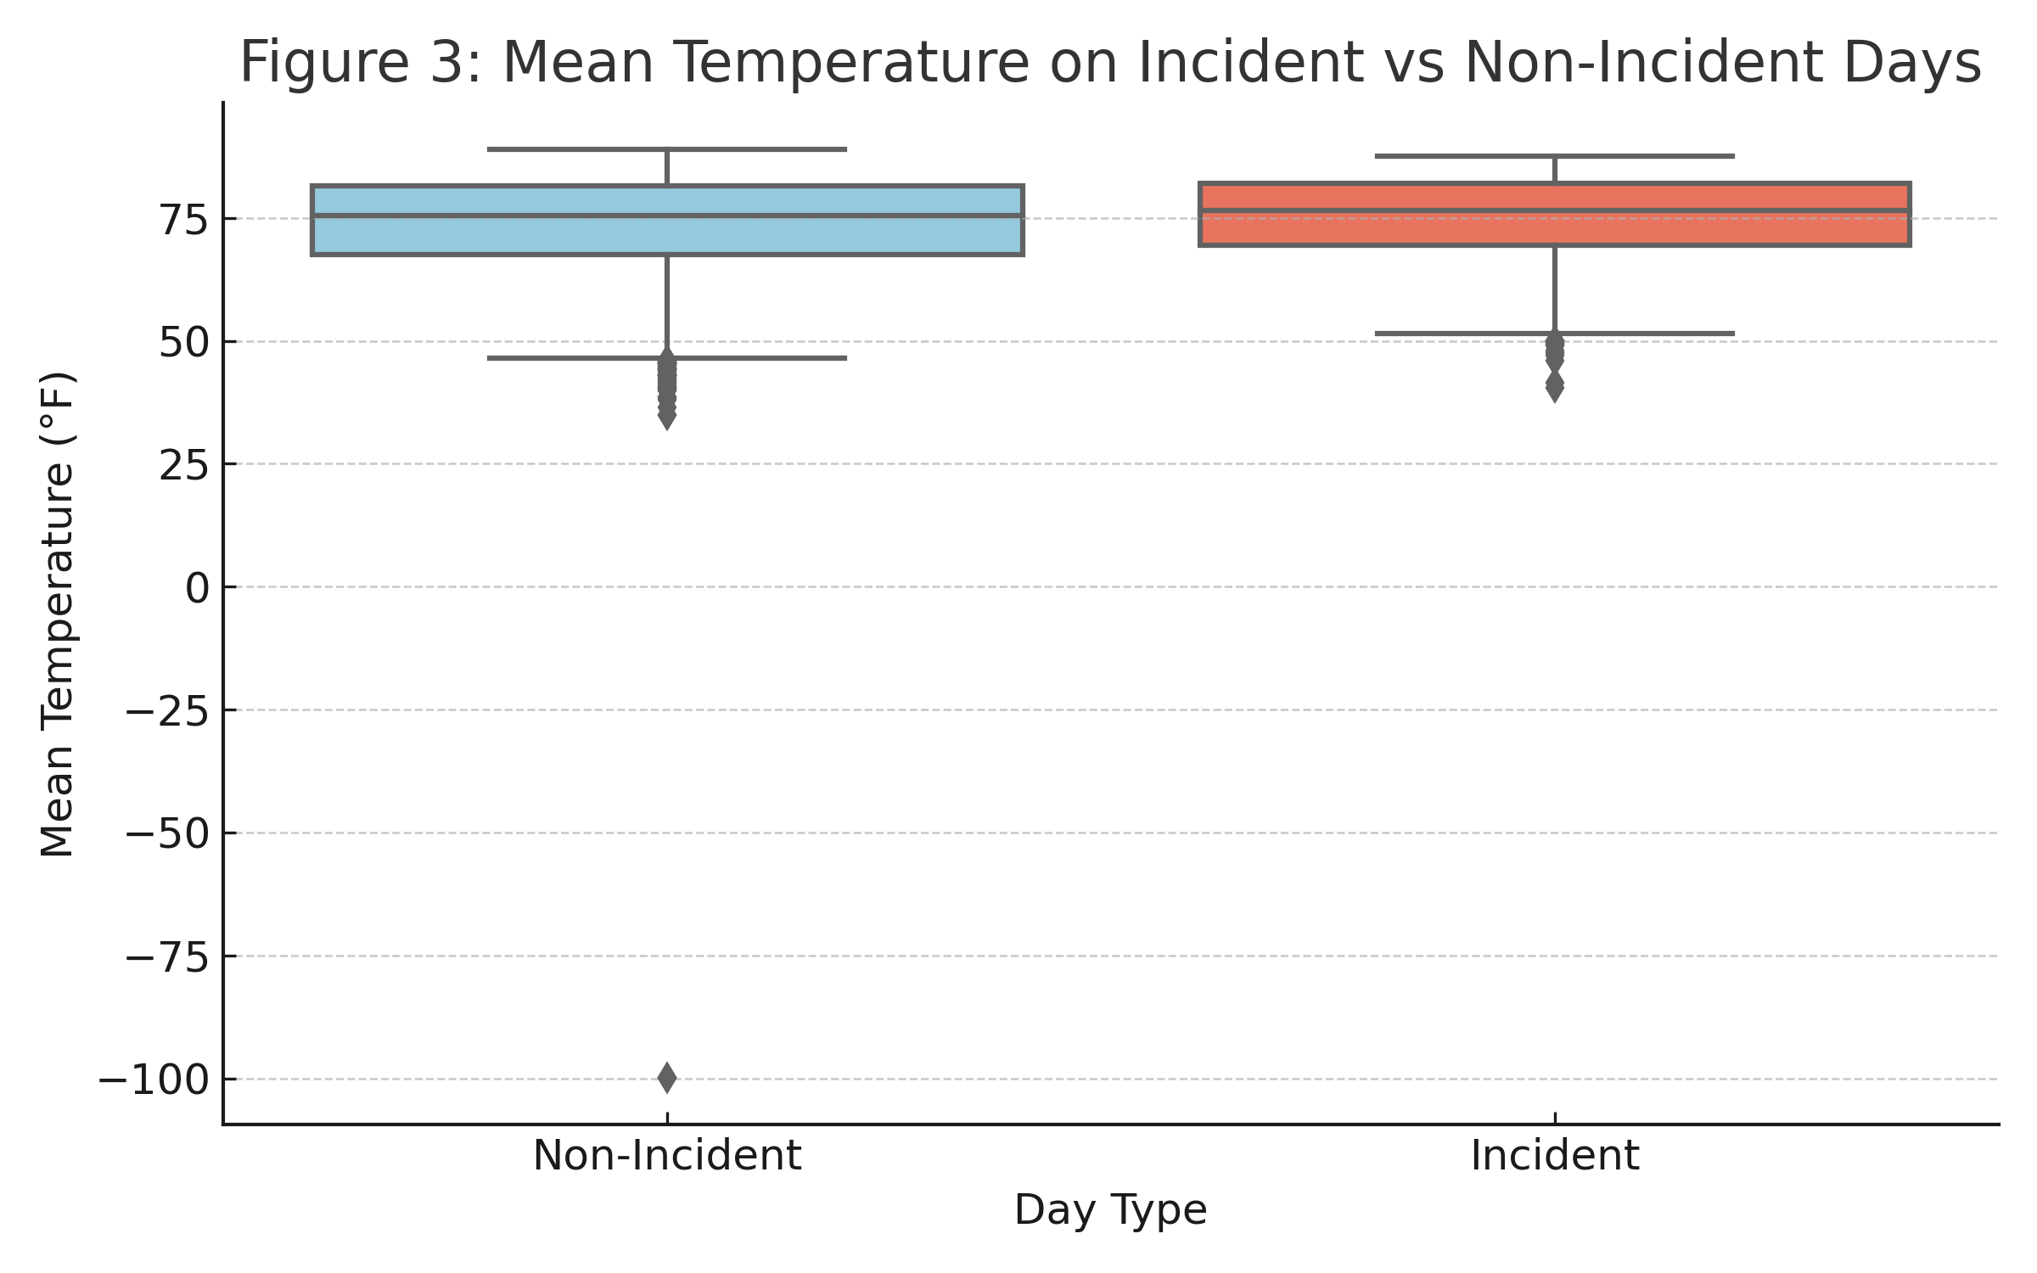
Notes:
Here we compared the temperature on days when incidents were reported versus days with no incidents. On average, incident days were hotter. In fact, nearly 15% of all incidents happened on just the hottest 10% of days. This shows that extreme heat may be a key factor in guest well-being.

Slide 10
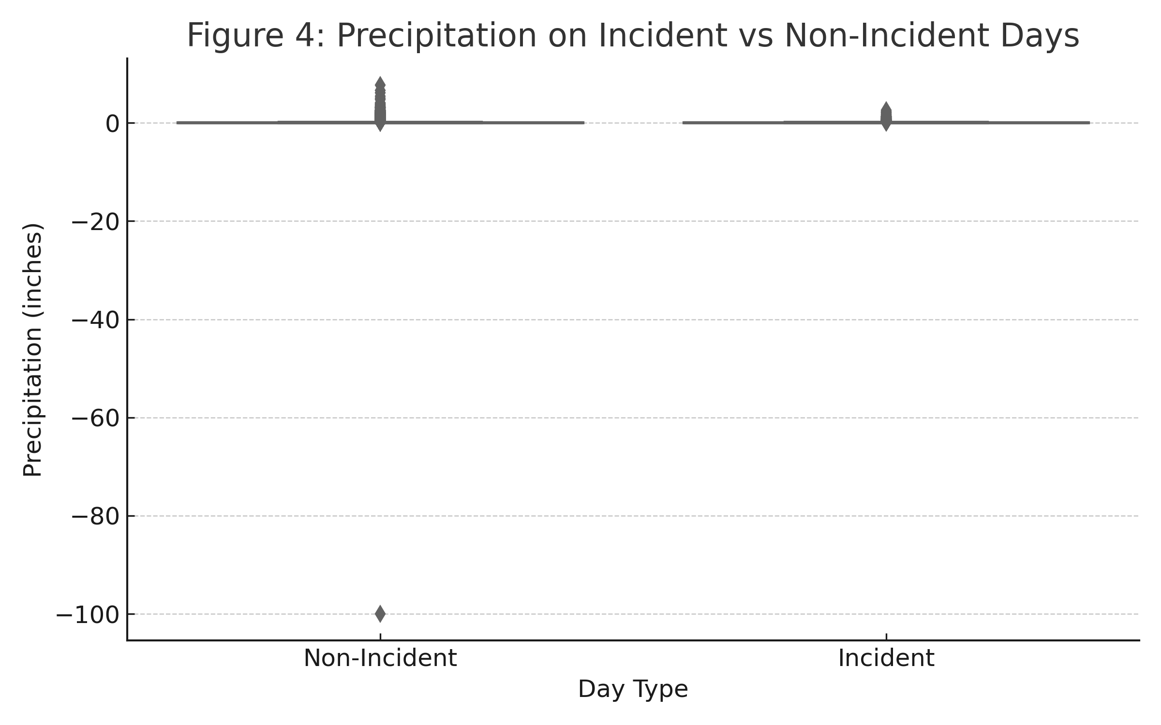
Notes:
In contrast, we didn’t see the same relationship with rain. Incident days didn’t have significantly more or less precipitation. This suggests that while heat may be a concern, rain alone doesn’t appear to increase the likelihood of incidents.

Slide 11
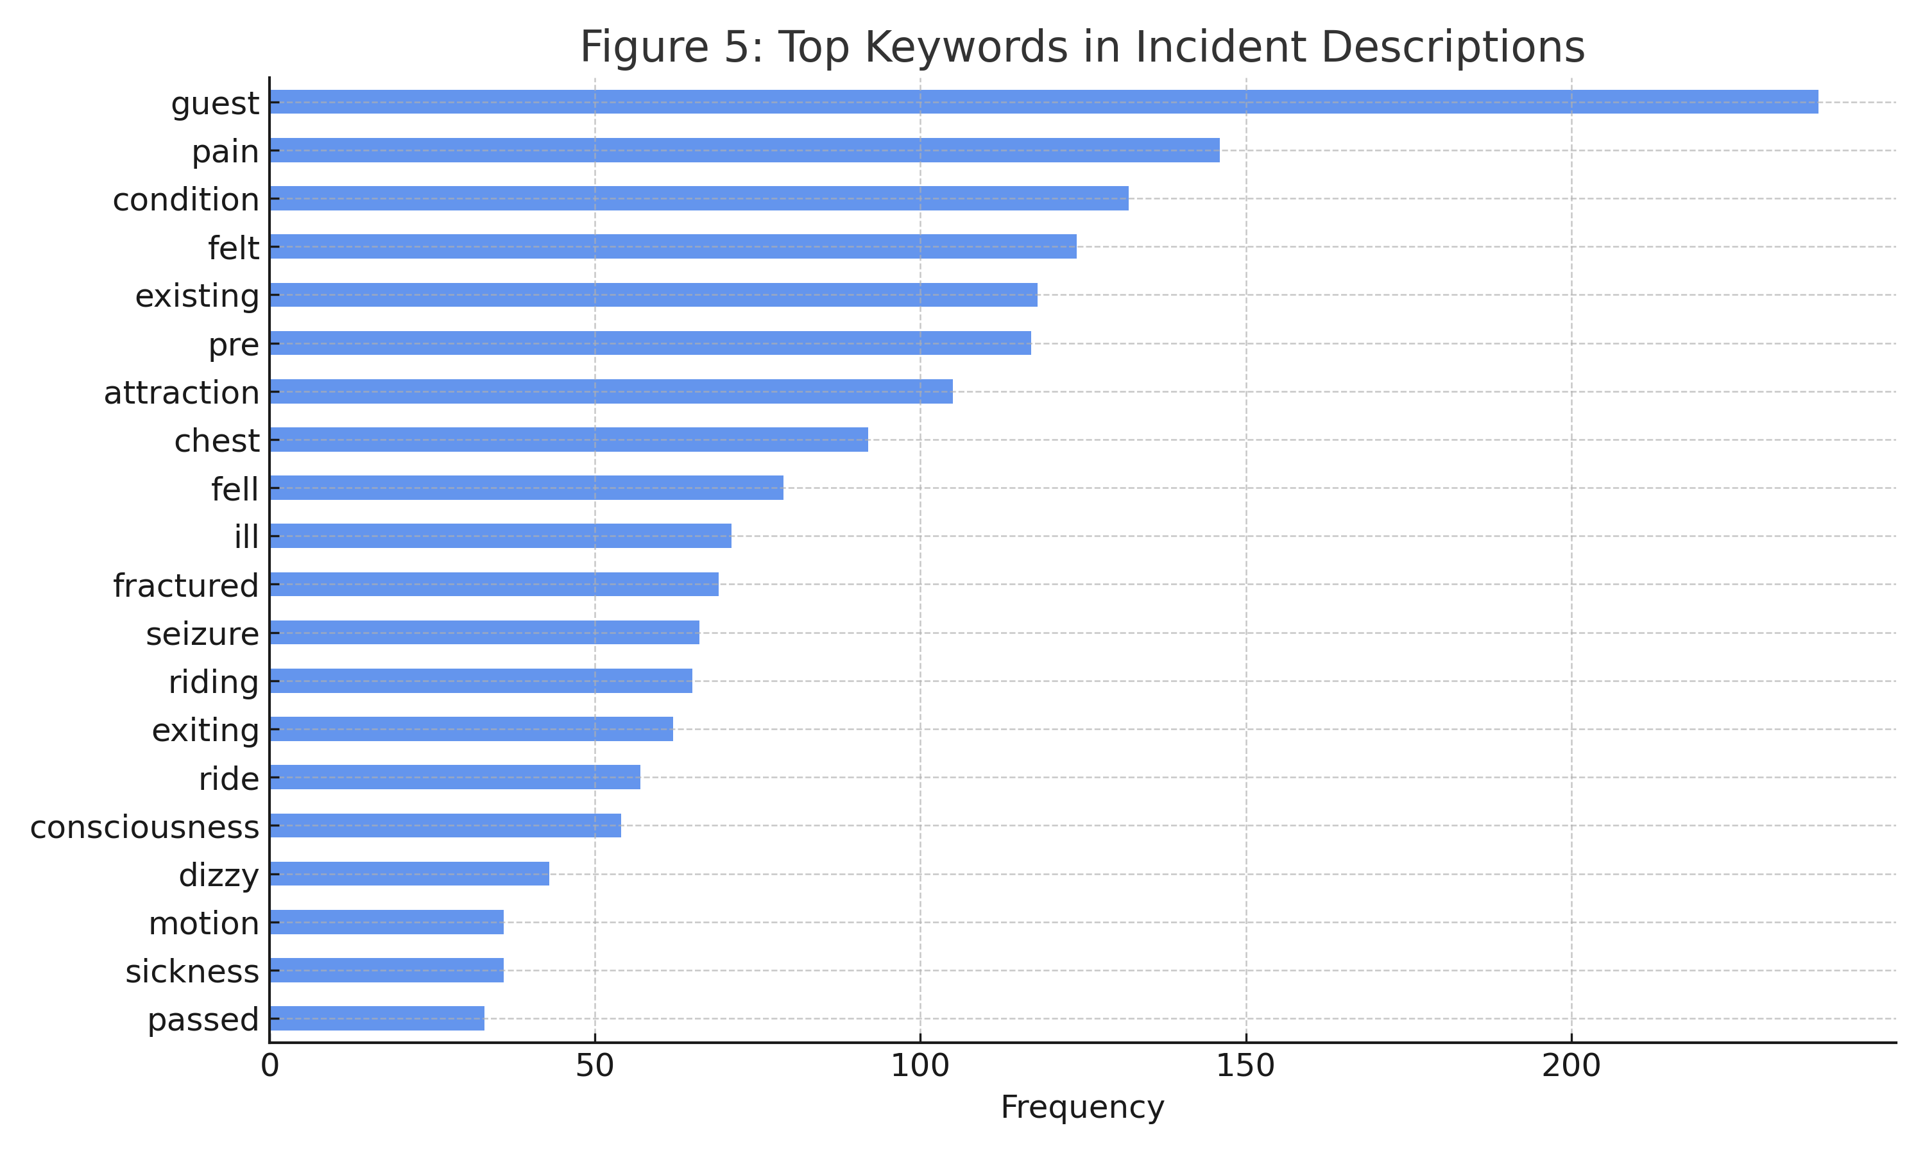
Notes:
We also used text analysis to study incident descriptions. Words like ‘pain,’ ‘consciousness,’ and ‘dizzy’ appeared frequently. These suggest that many incidents are tied to physical discomfort — often heat-related or tied to guest conditions. This kind of insight could be useful for safety planning or signage. Together, these charts helped shape our model and the recommendations we’ll look at next.

Slide 12
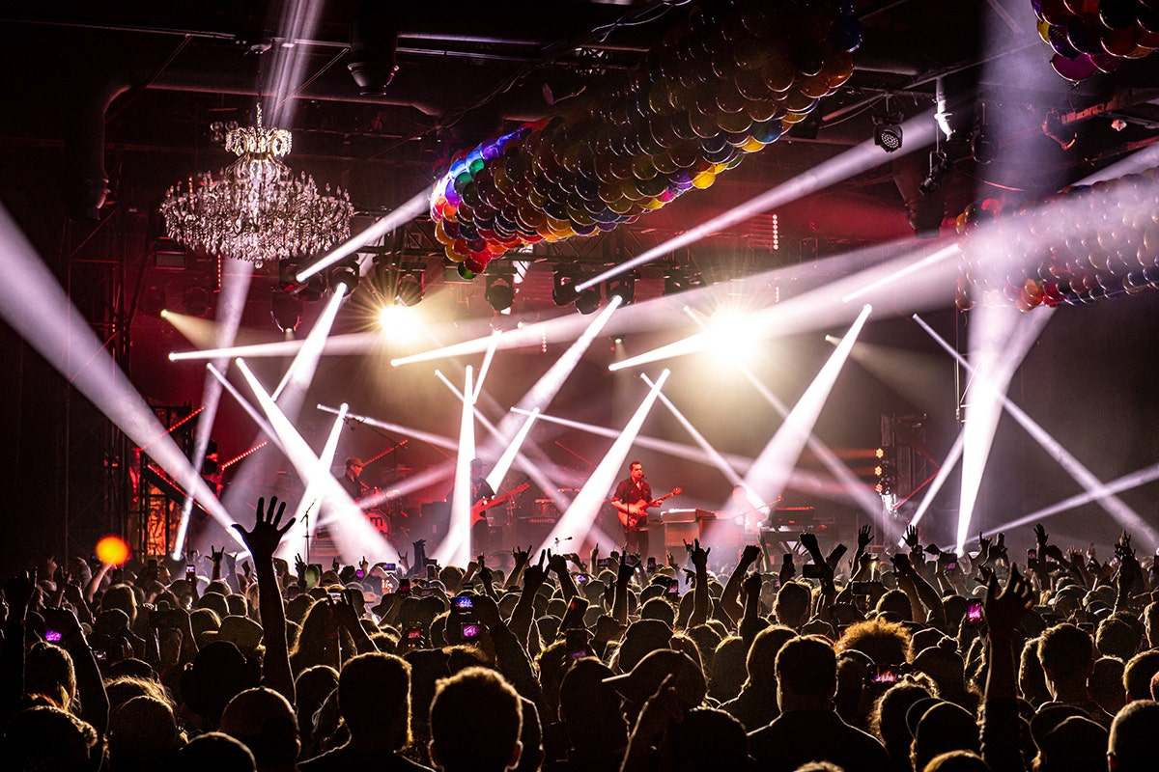
Recommendations & Applications
Use real-time dashboards for incident risk
Preemptive staff deployment on hot days
Expand to other parks, festivals, airports
Notes:
Based on the findings, we recommend creating real-time dashboards to monitor incident risk using weather data. Parks can use this to shift staffing, monitor hydration stations, and prepare for high-risk days. The framework can also be adapted to other venues like concerts or festivals.

Slide 13

Ethical Considerations
No demographic data used
Avoid over-reliance on automated risk scoring
Reports may be incomplete
No crowd data available
Notes:
Ethically, we excluded demographics to avoid bias. We also recognize that not all incidents are reported, and we lacked real crowd data. Still, the analysis highlights environmental risks without overstepping privacy boundaries.

Slide 14

Common Questions
Can this run in real time?
What data would improve it?
How do you prevent bias?
Could this work at other parks?
Notes:
Let me walk through a few common questions I’ve received about this project.
First — can this run in real time? Yes, the model is lightweight and can work with live weather feeds to flag high-risk conditions.
What would make it even better? Adding attendance data, crowd density, or even medical response times would give a much clearer picture.
A big question is about bias — how did you avoid it? I chose not to use any guest demographics like age or gender. That helped keep the model focused on environmental and ride-based factors.
And finally, could this work outside of Orlando? Definitely. The same approach could be used in other parks, events, or even places like festivals and airports — anywhere crowd safety is a concern.

Slide 15
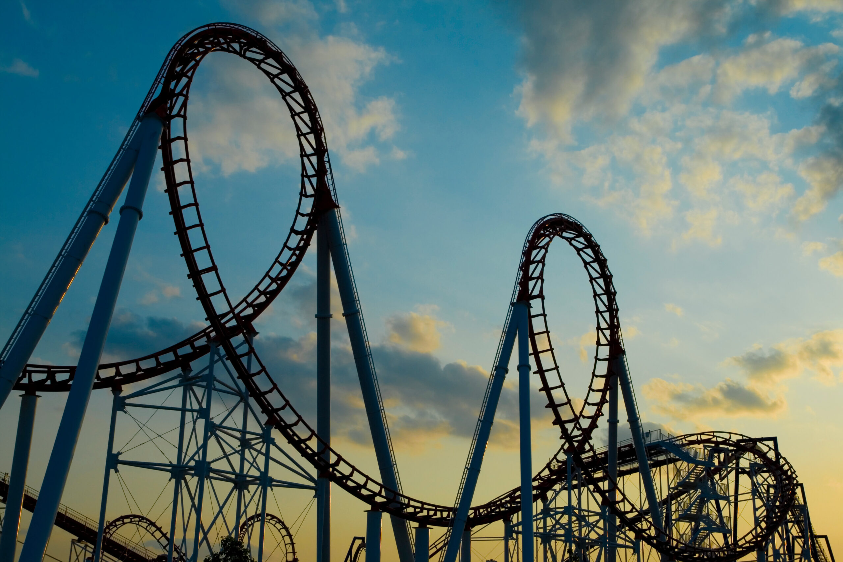
THANK YOU!
Questions? Please feel free to reach out at miles.a.pena@gmail.com
Notes:
And that’s the big picture! Thanks so much for listening — I really enjoyed sharing this with you. I hope it sparked some ideas about how data can make theme parks even safer and smarter. I’m happy to answer any questions you’ve got!

